Slide 1
Exam 70-777 Implementing Microsoft Azure Cosmos DB Solutions
Partition and Model Data
Replicate Data Across the World
Tune and Debug Azure Cosmos DB Solutions
Perform Integration and Develop Solutions
Speaker Information:
https://www.microsoft.com/en-ie/learning/exam-70-777.aspx
Notes:
20533D
1: Introduction to Microsoft Azure

Slide 2
Replicate Data Across the World
Implement global distribution and high availability
Select a data consistency approach based on business use cases

Slide 3
Replicate Data Across the World
Implement global distribution and high availability
Replicate data to additional regions; define automatic failover policies for disaster recovery; perform manual failovers to change the write region; set the preferred location of applications for low-latency access; design patterns for multi-write regions; resolve conflicts surfaced by the conflict feed
Select a data consistency approach based on business use cases
Identify use cases for consistencies; differentiate between consistencies by using characteristics; differentiate between consistencies by using trade-offs between performance and consistency; use session tokens
https://www.microsoft.com/en-us/learning/exam-70-777.aspx
Notes:
The following topics are not included in this presentations due to time constrains

Slide 4
Implement global distribution and high availability
Replicate data to additional regions
Define automatic failover policies for disaster recovery
Perform manual failovers to change the write region
Set the preferred location of applications for low-latency access
Design patterns for multi-write regions
Resolve conflicts surfaced by the conflict feed

Slide 5
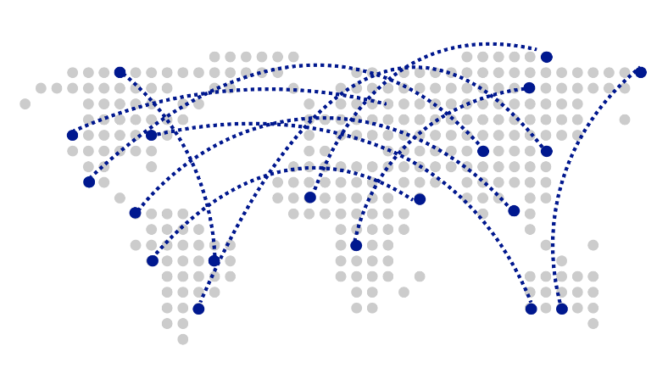

Global Distribution

Slide 6
Global Distribution
Why Global Distribution
High Availability
Automatic and Manuel Failover
Multi-homing API removes need for app redeployment
Low Latency (anywhere in the world)
Packets cannot move fast than the speed of light
Sending a packet across the world under ideal network conditions takes 100’s of milliseconds
You can cheat the speed of light – using data locality
CDN’s solved this for static content
Azure Cosmos DB solves this for dynamic content
https://docs.microsoft.com/en-us/azure/cosmos-db/distribute-data-globally
Notes:
BCR
Important to manually failover? Testing for RTO and RPO how long does it take you to go back online
Built in to the SDK, if the primary fails, then it detects it and fails-over
No switch back
prima
Cosmos DB is a Foundational (Ring 0) Azure service
Available in all Azure regions by default, including sovereign/government clouds
Transparent and automatic multi-region replication
Associate any number of regions with your database account, at any time
Policy based geo-fencing
Multi-homing APIs
All endpoints are logical, by default
Apps don’t need to be redeployed during regional failover
Apps can also access physical endpoints if needed
Support for both manual and automatic failover
Designed for high availability
Allows for dynamically setting priorities to regions
Simulate regional disasters via API
Test the end-to-end availability for the entire app (beyond just the database)

Slide 7
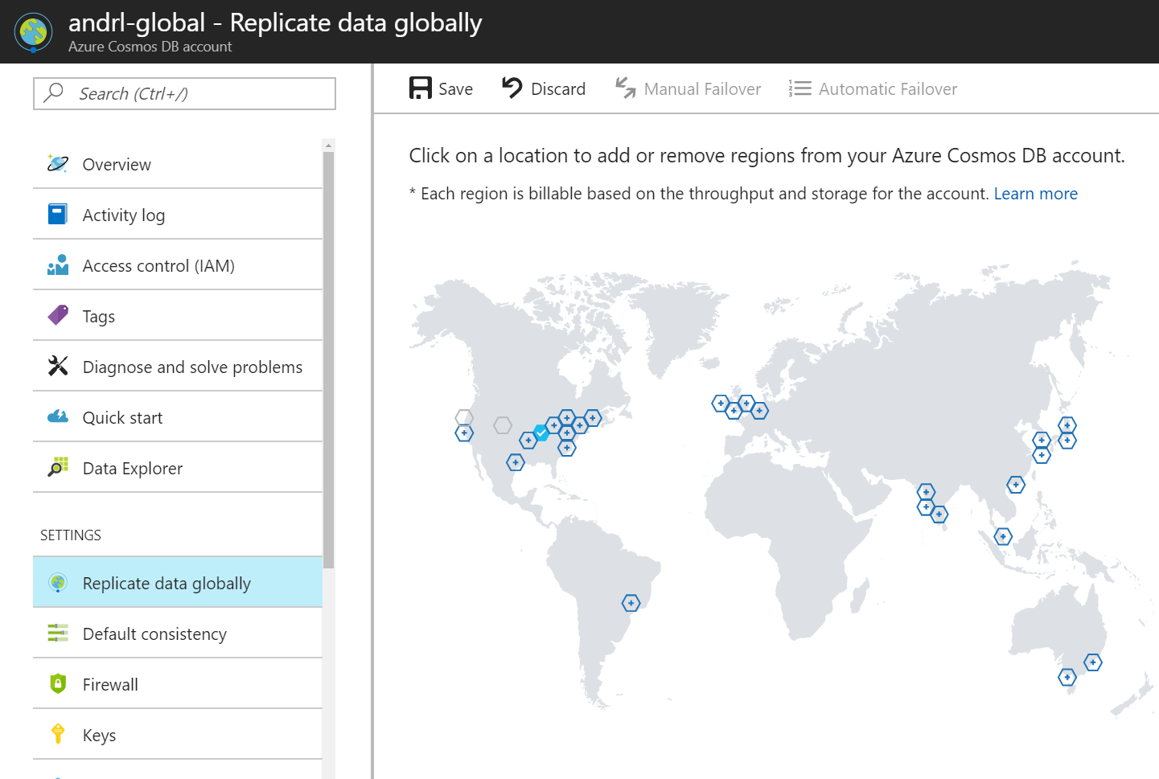
Global Distribution

Slide 8
Global Distribution

Slide 9
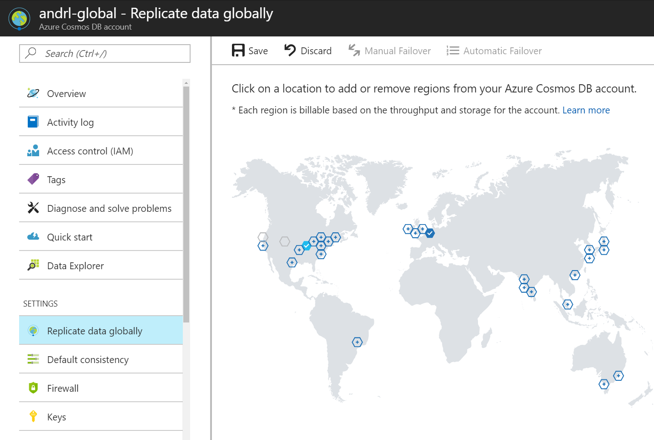
Global Distribution

Slide 10

Global Distribution

Slide 11
Global Distribution

Slide 12
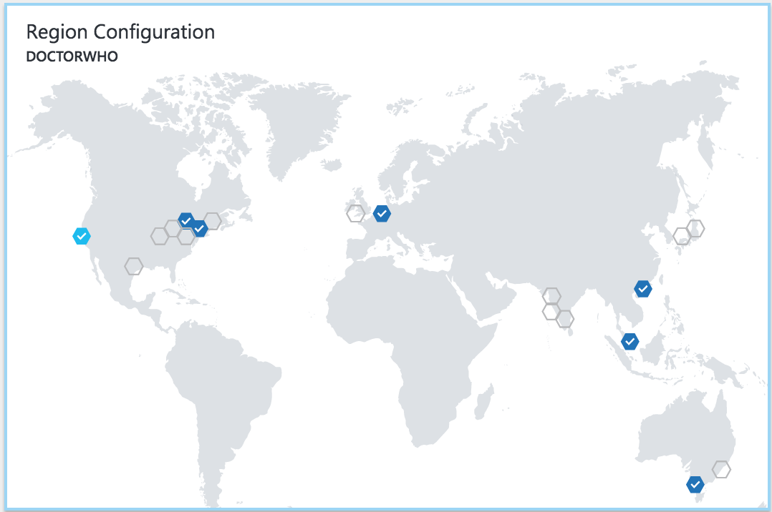


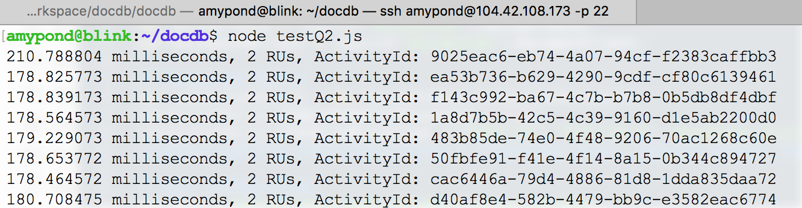
Global Distribution

Slide 13
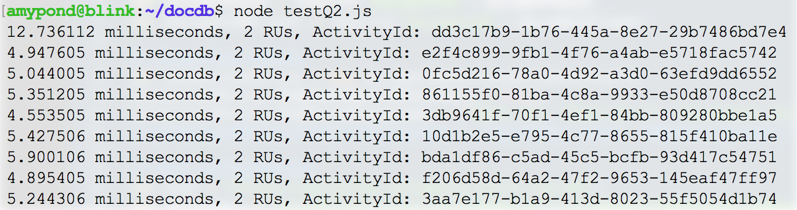
Global Distribution

Slide 14
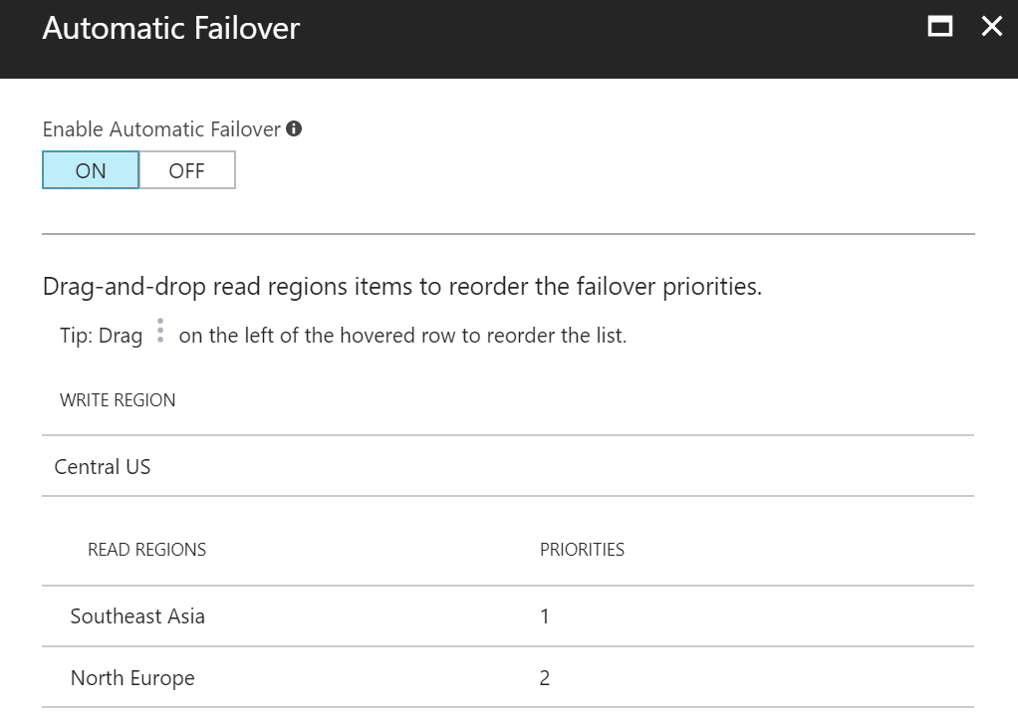
Automatic Failover

Slide 15
Automatic Failover
https://docs.microsoft.com/en-us/azure/cosmos-db/regional-failover

Slide 16
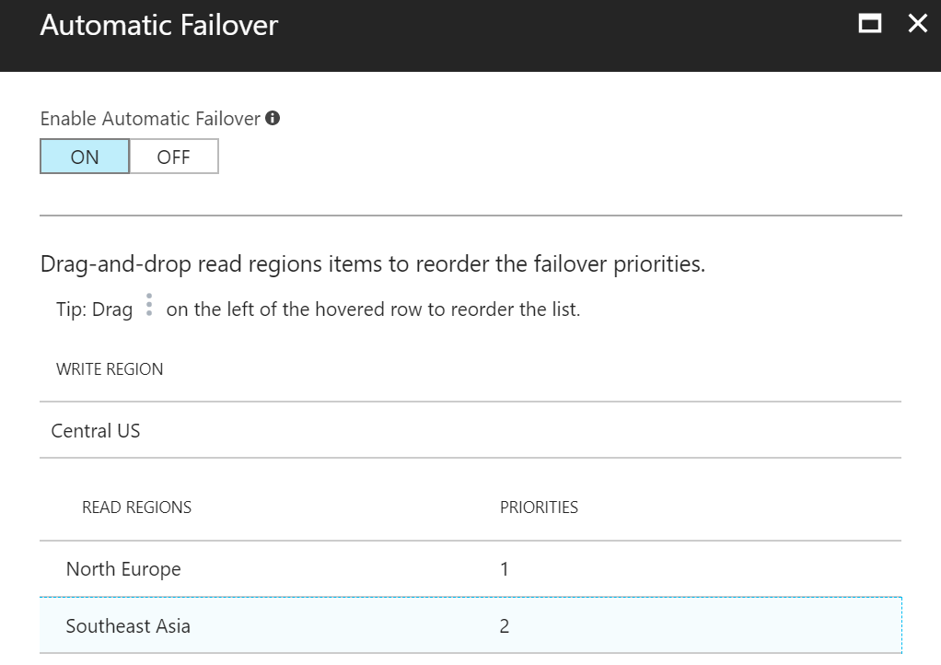
Automatic Failover

Slide 17
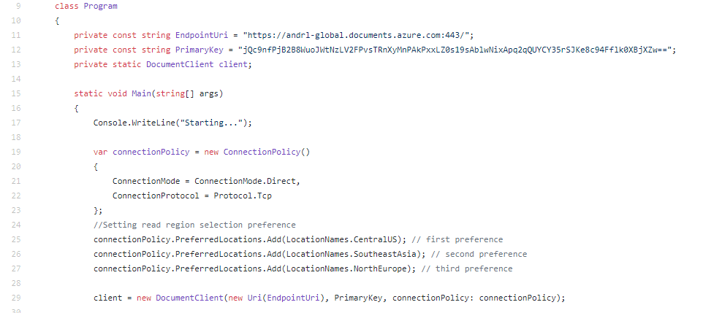
Preferred location

Slide 18
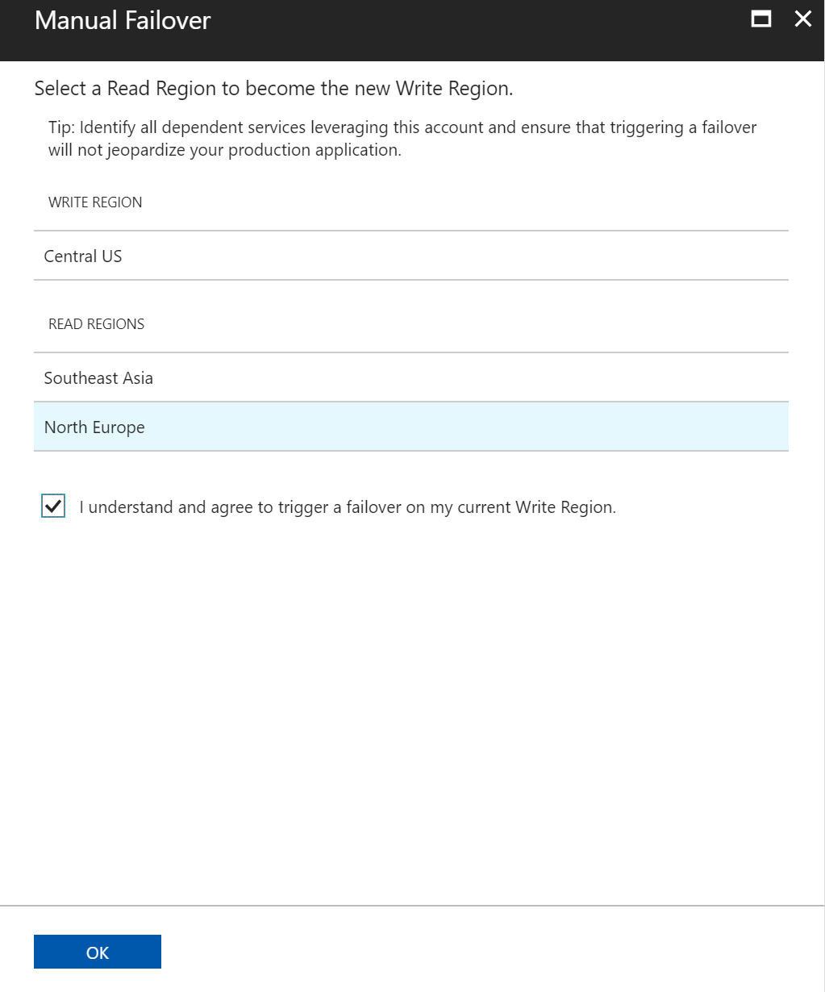
Manual Failover

Slide 19
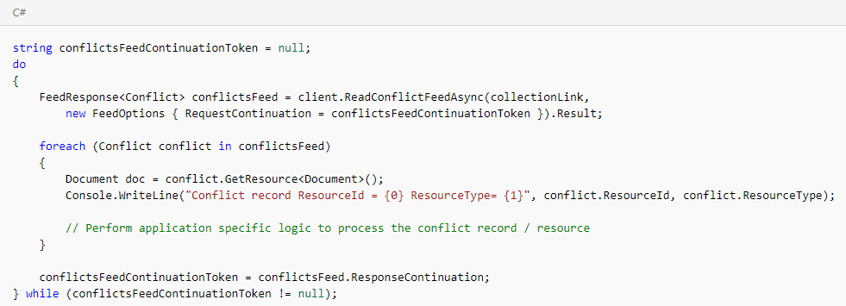
Conflict feed
Notes:
Once the affected region recovers from the outage, all the affected Cosmos DB accounts in the region are automatically recovered by the service.
Data present in the previous write region that was not replicated to read regions during the outage is published as a conflict feed. Applications can read the conflict feed, resolve the conflicts based on application specific logic, and write the updated data back to the Azure Cosmos DB account as appropriate.
The previous write region is recreated as a read region and brought back online automatically.
You can reconfigure read region that was brought back online automatically as the write region by performing a manual failover via the Azure portal or programmatically.

Slide 20
Configuring for Global Distribution
Configuring for Global Distribution
Notes:
Exercise: Configuring for Global Distribution
Important: Prior to getting started with this hands-on exercises, you should have already completed the Getting Started: Creating a Azure Cosmos DB Instance hands-on exercise.
In a new browser window, sign in to the Azure Portal (https://portal.azure.com).
In the Jumpbar, click More Services, locate the Databases section, and then click Azure Cosmos DB.
In the Azure Cosmos DB blade that opens, locate and click the Azure Cosmos DB account instance you created earlier in this module.
In the menu on the left-side of the Azure Cosmos DB account blade, locate the Settings section and then click the Replicate data globallyoption in the menu.
In the Replicate data globally blade, select an additional (second) region by clicking the region's icons on the global map.
Click the Save button. Wait for the “Add/Remove Regions” operation to complete.
The Manual Failover button should now be enabled. Click the Manual Failover button.
Once you add a second Region, the manual failover option is enabled and allows you to manually select that region to become the new Write Region.
In the Manual Failover blade, select the only region option available in the Read Regions list.
Click the checkbox to confirm that you agree to trigger a failover and then click the OK button to perform the failover action. Wait for the “Manual Failover” operation to complete.
You should now notice that your Read and Write Regions have been swapped.
In the Replicate data globally blade, select an additional (third) region by clicking the region's icons on the global map.
Click the Save button. Wait for the “Add/Remove Regions” operation to complete.
The Failover Priorities button should now be enabled. Click the Failover Priorities button.
Once you add a third Region, the failover priorities option is enabled and allows you to change the failover order for regions.
In the Failover Priorities blade, observe the current priority order.
Close the Failover Priorities blade.
Source: edx.org
Microsoft: DAT221xIntroduction to NoSQL Data Solutions

Slide 21
Select a data consistency approach based on business use cases
Identify use cases for consistencies
Differentiate between consistencies by using characteristics
Differentiate between consistencies by using trade-offs between performance and consistency
Use session tokens

Slide 22
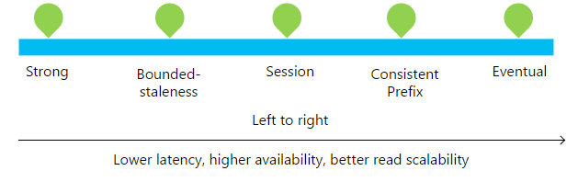
Consistency
Notes:
What is the essence of the cap therme? Trade offs
Why?
Things are not instantaneous
So vertical vs horizontal
Strong
Bound staleness
Session
Consistent prefix : ordering guarantee
Eventual

Slide 23
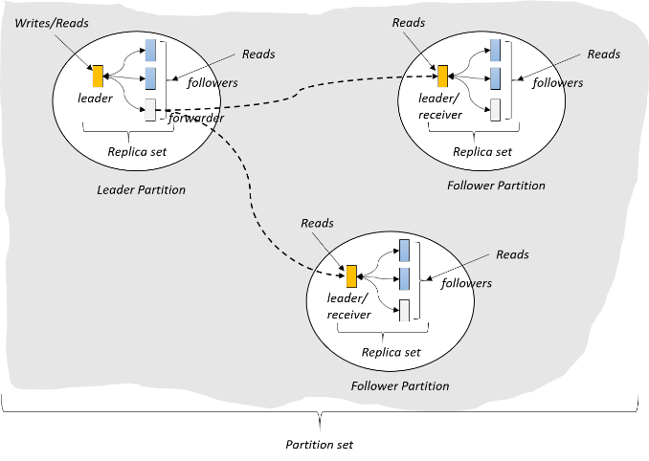
Consistency
(West US)
(East US)
(North Europe)
https://azure.microsoft.com/en-us/resources/videos/azure-cosmosdb-consistency/
Notes:
To get from Primary to secondary, 200 ms

Slide 24
Consistency
Value = 5
Value = 5
Value = 5
Notes:
All values synced

Slide 25
Consistency
Value = 5 6
Update 5 => 6
Value = 5
Value = 5
Notes:
Updated primary

Slide 26
Consistency
Value = 5 6
Update 5 => 6
Value = 5 6
Value = 5
What happens when a network partition is introduced?
Notes:
Something went wrong
Can’t get the data over.
What are the two available options when reading from secondary?
Can wait until flushing over the data
Or fall back to primary

Slide 27
Consistency
Value = 5 6
Update 5 => 6
Value = 5 6
Value = 5
What happens when a network partition is introduced?
Reader: What is the value?
Should it see 5? (prioritize availability)
Or does the system go offline until network is restored? (prioritize consistency)

Slide 28
Consistency
Brewer’s CAP Theorem: impossible for distributed data store to simultaneously provide more than 2 out of the following 3 guarantees:
Consistency, Availability, Partition Tolerance
https://en.wikipedia.org/wiki/CAP_theorem
Notes:
Can be on the exam
CAP theorem is a tradeoff

Slide 29
Consistency
Latency: packet of information can travel as fast as speed of light.
Replication between distant geographic regions can take 100’s of milliseconds
Value = 5 6
Update 5 => 6
Value = 5 6
Value = 5
Notes:
What happens with latency?
If it takes long, what is goin on?

Slide 30
Consistency
Reader A: What is the value?
Value = 5 6
Update 5 => 6
Value = 5 6
Value = 5
Reader B: What is the value?

Slide 31
Consistency
Reader A: What is the value?
Value = 5 6
Update 5 => 6
Value = 5 6
Value = 5
Reader B: What is the value?
Should it see 5 immediately? (prioritize latency)
Does it see the same result as reader A? (quorum impacts throughput)
Or does it sit and wait for 5 => 6 propagate? (prioritize consistency)
Notes:
Casandra can decticate a corom and what is the majority value,
But the latency increases, because it takes as long as the farthest one

Slide 32
Consistency
PACELC Theorem: In the case of network partitioning (P) in a distributed computer system, one has to choose between availability (A) and consistency (C) (as per the CAP theorem), but else (E), even when the system is running normally in the absence of partitions, one has to choose between latency (L) and consistency (C).
Notes:
Expanded theorem
Even if there are no times where network experience ..
You still have to consider this

Slide 33

Programmable Data Consistency
Choice for most distributed apps
Strong consistency High latency
Eventual consistency, Low latency

Slide 34
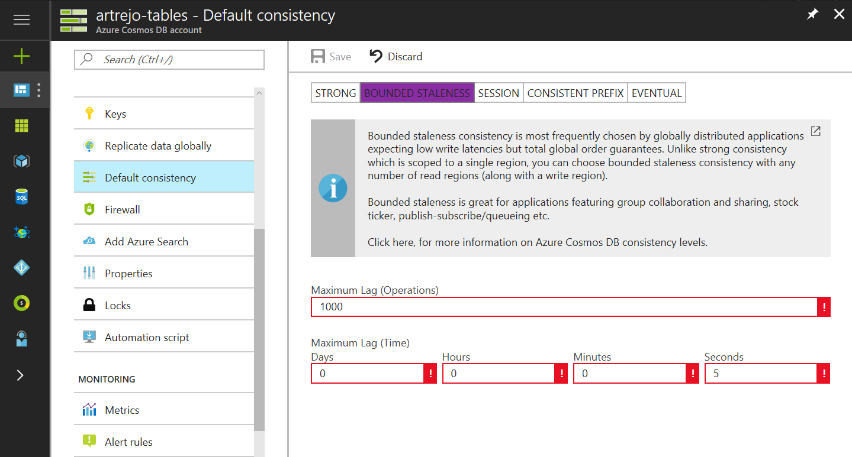

Well-defined consistency models
Intuitive programming model
5 Well-defined, consistency models
Overridable on a per-request basis
Clear tradeoffs
Latency
Availability
Throughput
https://docs.microsoft.com/en-us/azure/cosmos-db/consistency-levels

Slide 35
Consistency models
Notes:
Ask what is what
Strong, every single node will commit before flushed seats and flights
Eventual: primary since it is master, with eventually it will merge. Never come to a state where machines have different data!
Bounded-staleness: cap on how stale it can get. Nothing any more stale than x number of operation, x number of seconds
Session: within a single connection, you set the limit.
I am guaranteed to see the write I did.
But if someone else is reading my change, they are not guaranteed to see the change I made
Consistent prefix: is the order of replication. So ABC garantees ABC
The write operation order
You don’t get invalid state where A didn’t propagate.
Really good for logging

Slide 36
Consistency models
Consistency Level | Guarantees
Strong | Linearizability (once operation is complete, it will be visible to all)
Bounded Staleness | Consistent Prefix. Reads lag behind writes by at most k prefixes or t interval Similar properties to strong consistency (except within staleness window), while preserving 99.99% availability and low latency.
Session | Consistent Prefix. Within a session: monotonic reads, monotonic writes, read-your-writes, write-follows-reads Predictable consistency for a session, high read throughput + low latency
Consistent Prefix | Reads will never see out of order writes (no gaps).
Eventual | Potential for out of order reads. Lowest cost for reads of all consistency levels.
Notes:
Monotonic : as writes are coming in you are always adding 1 or incremental and predictable matter so ABC

Slide 37
Consistency models
Bounded-Staleness: Bounds are set server-side via the Azure Portal

Slide 38
Consistency models
Session Consistency: Session is controlled using a “session token”.
Session tokens are automatically cached by the Client SDK
Can be pulled out and used to override other requests (to preserve session between multiple clients)
string sessionToken;
using (DocumentClient client = new DocumentClient(new Uri(""), ""))
{
ResourceResponse<Document> response = client.CreateDocumentAsync(
collectionLink,
new { id = "an id", value = "some value" }
).Result;
sessionToken = response.SessionToken;
}
using (DocumentClient client = new DocumentClient(new Uri(""), ""))
{
ResourceResponse<Document> read = client.ReadDocumentAsync(
documentLink,
new RequestOptions { SessionToken = sessionToken }
).Result;
}

Slide 39
Consistency models
Consistency can be relaxed on a per-request basis
client.ReadDocumentAsync(
documentLink,
new RequestOptions { ConsistencyLevel = ConsistencyLevel.Eventual }
);

Slide 40
Session tokens
Each new write request to Azure Cosmos DB is assigned a new SessionToken. The DocumentClient will use this token internally with each read/query request to ensure that the set consistency level is maintained
https://docs.microsoft.com/en-us/dotnet/api/microsoft.azure.documents.client.requestoptions.sessiontoken?view=azure-dotnet

